Slide 1


Computer Based Engineering Mathematics Summer Semester 2018
Project : Vibration of a string
Cordinators:
Prof. Dr. Johannes Gottschling
Dipl.-Math. Robert Martin
Institute for Applied Material technology
Universität Duisburg-Essen
Group members:
Md Abu Saym (3022015)
Sadek Dewan (3056001)
Mohammad khademul Amin(3022194)
Azahar Hossain(3056371)
Abdullah Al Mamun(xxxxx)

Slide 2
Table of Contents
Introduction
Mathematical formula
Problem & Solution
Program
Conclusion

Slide 3

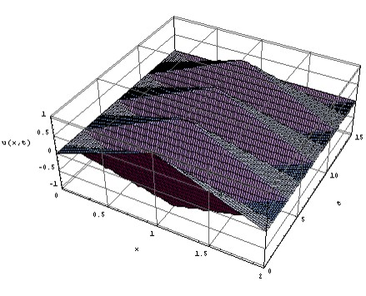
Project 1 – Vibration of a string
where u (x; t) is the displacement of the string at the point x and the time t, the real number c > 0 is a material constant, L is the length of the vibrating string, f is the initial displacement and g is the initial velocity of the string; note that all constants and variables are written without dimension.

Slide 4
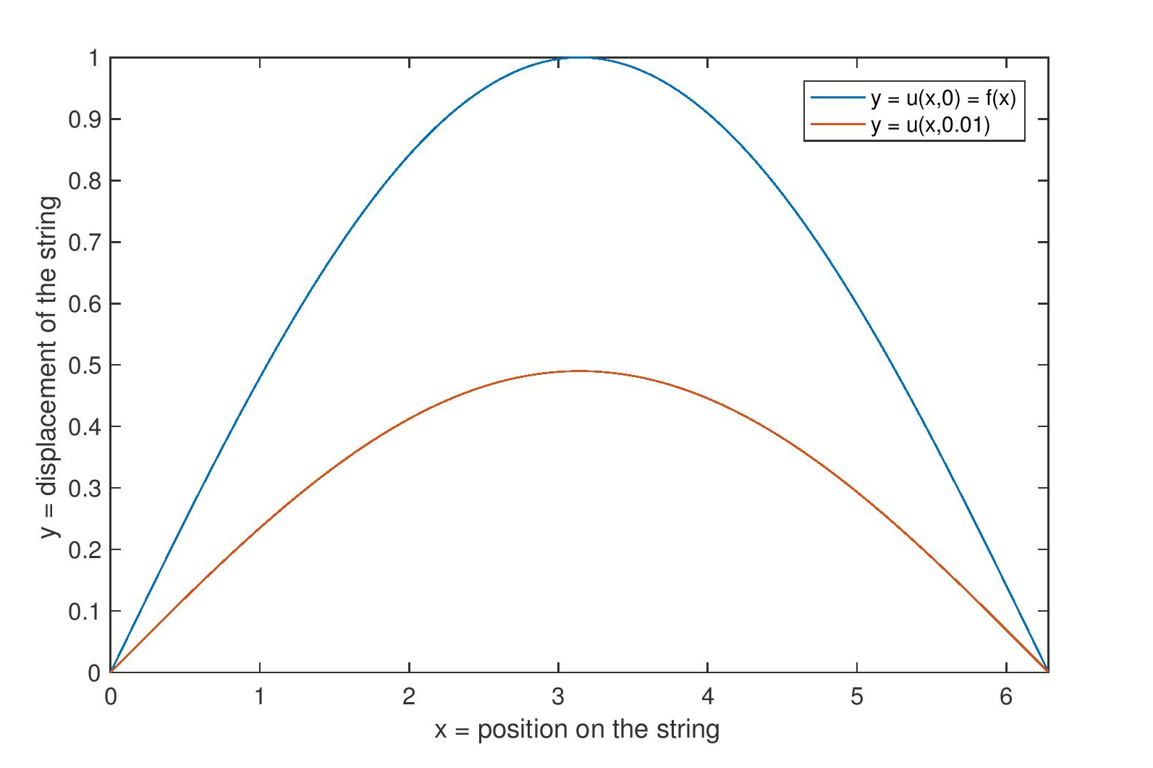
Figure 1: Displacement of a string with length L = 2π at the times t = 0 and t = 0:01.

Slide 5
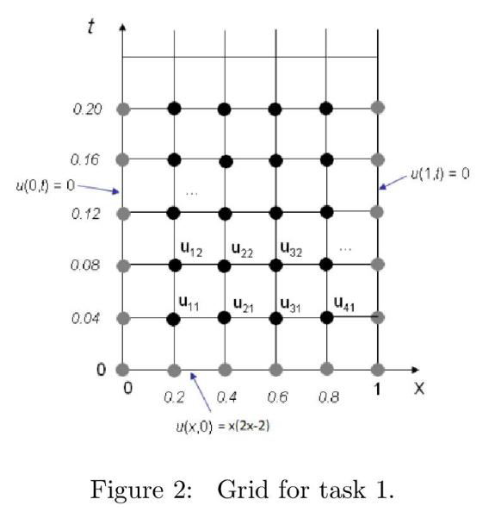
Task 1:
Using the methods introduced in Section 1.1 of the script (“Motivation”), find (an approximation of) the displacement function u of a vibrating string for
The grid given in Fig. 2
C=1
L = 1
the initial velocity zero,
the initial displacement f with
f(x) = x · (x − 2) · (x − 1).
Plot the (three-dimensional) graph of u(·,·) and the (two-dimensional) graphs of u(·,0), u(·,π) and u(·,2π).

Slide 6
Task 2:
Write a MATLAB function which takes the input arguments
f (the initial displacement function),
h (the grid size in x-direction),
k (the grid size in t-direction),
T (the endpoint of the time interval)
and returns the (approximate) solution to problem (1) for c = 1, L = 1,
zero initial velocity and the given initial displacement f on the grid given by h, k and T

Slide 7
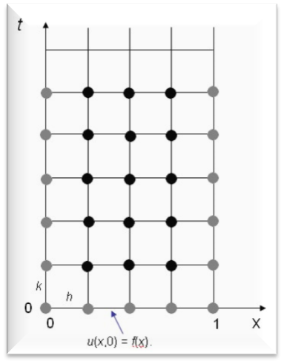
Task 2 (Cont’d)
Your project solution must be a file called
waveSolution.m of the following form:
function [ u ] = waveSolution( f, h, k, T )
% your code% ...
end
The return value u must be in the form of a matrix; more specifically: u(m,n) must be the value u((m-1) . h; (n-1). k/T) of the solution u at the (m; n)-grid point, see Fig. 3.

Slide 8
Theory and mathematical formula
The main task of this project is to find the displacement of a sting which is fixed in both ends at various points in given grid. We do it using matrices extensively.
Au=B is the main formula used, where A is the coefficient matrix, B is the boundary matrix and u is the resulting temperature matrix.
h = Δx
k = Δt
The differential Vibration equation provided is
............................(1)

Slide 9
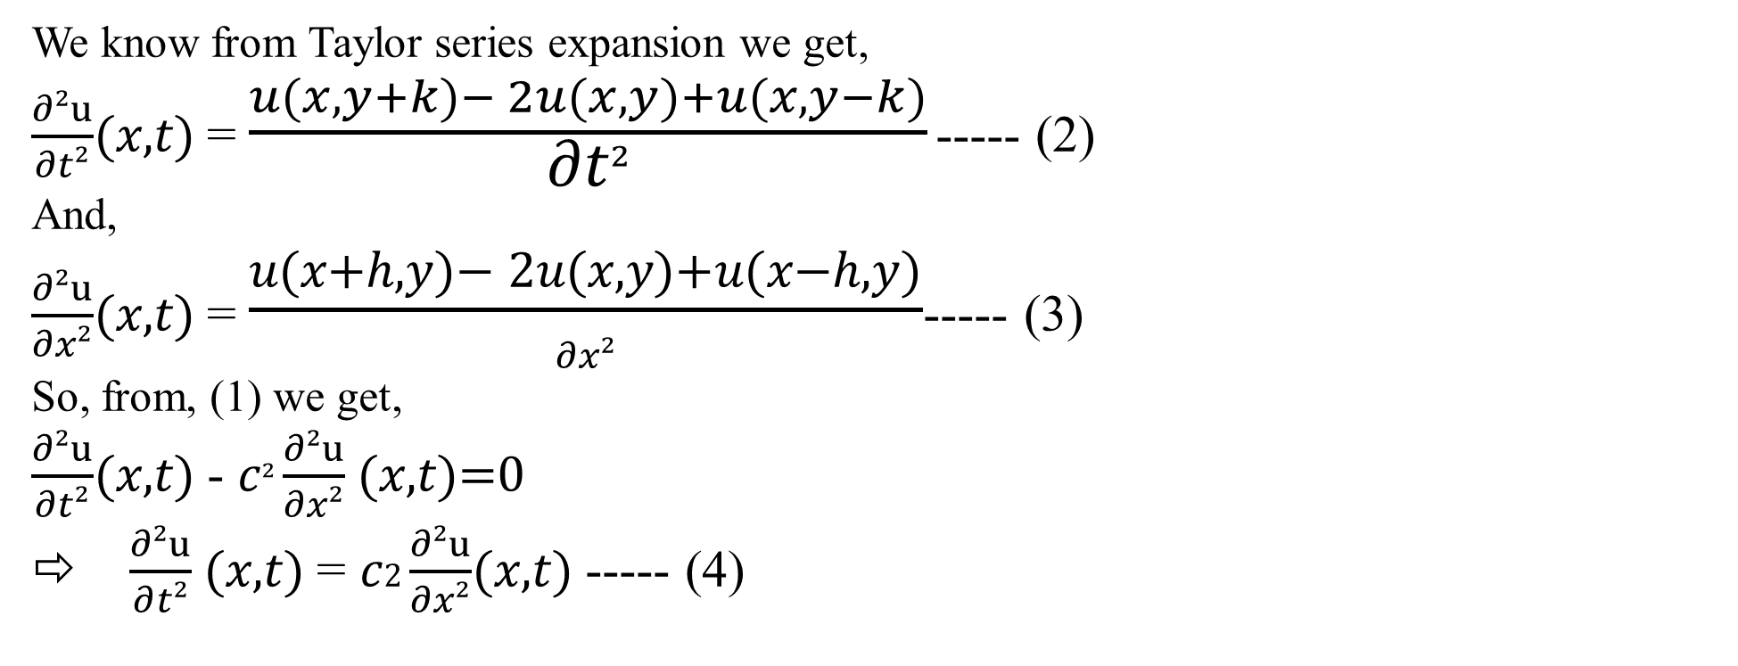
Theory and mathematical formula
We know from Taylor series expansion we get,
$\frac{∂²u}{∂t²}$(𝑥,𝑡) = $\frac{u(x,y+k)− 2u(x,y)+u(x,y−k)}{\text{∂}\text{t}²}$ ----- (2)
And,
$\frac{∂²u}{∂x²}$(𝑥,𝑡) = $\frac{\text{u}\text{(}\text{x}\text{+}\text{h}\text{,}\text{y}\text{)− 2}\text{u}\text{(}\text{x}\text{,}\text{y}\text{)+}\text{u}\text{(}\text{x}\text{−}\text{h}\text{,}\text{y}\text{)}}{∂x²}$----- (3)
So, from, (1) we get,
$\frac{∂²u}{∂t²}$(𝑥,𝑡) - 𝑐² $\frac{∂²u}{∂x²}$(𝑥,𝑡)=0
⇨ $\frac{∂²u}{∂t²}$(𝑥,𝑡) = 𝑐2 $\frac{∂²u}{∂x²}$(𝑥,𝑡) ----- (4)

Slide 10
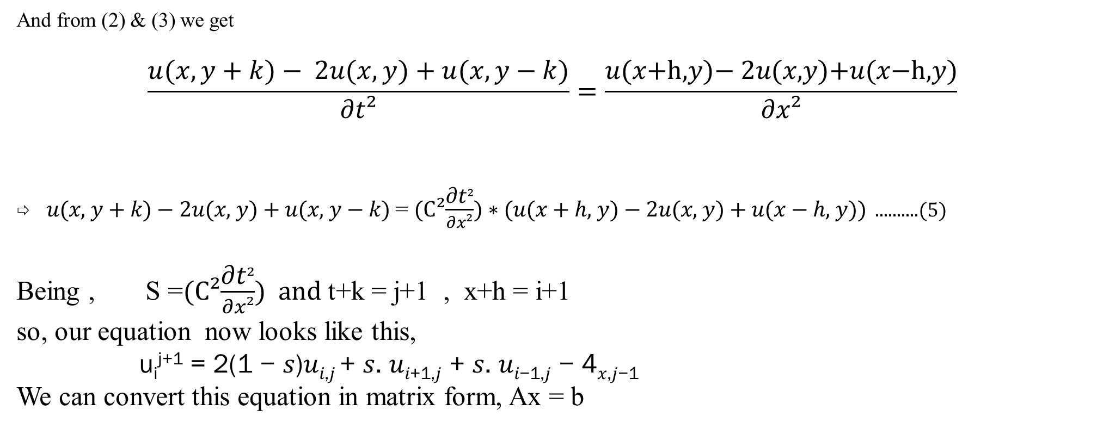
Theory and mathematical formula
And from (2) & (3) we get
$$\frac{u(x,y+k)− 2u(x,y)+u(x,y−k)}{\text{∂}\text{t}²}=\frac{\text{u}\text{(}\text{x}\text{+}\text{h}\text{,}\text{y}\text{)− 2}\text{u}\text{(}\text{x}\text{,}\text{y}\text{)+}\text{u}\text{(}\text{x}\text{−}\text{h}\text{,}\text{y}\text{)}}{∂x²}$$
⇨ 𝑢(𝑥, 𝑦 + 𝑘) − 2𝑢(𝑥, 𝑦) + 𝑢(𝑥, 𝑦 − 𝑘) = (C²$\frac{\text{∂}\text{t}²}{∂x²}$) ∗ (𝑢(𝑥 + ℎ, 𝑦) − 2𝑢(𝑥, 𝑦) + 𝑢(𝑥 − ℎ, 𝑦)) ..........(5)
Being , S =(C²$\frac{\text{∂}\text{t}²}{∂x²}$) and t+k = j+1 , x+h = i+1
so, our equation now looks like this,
u_{i}^{j+1} = 2(1 − 𝑠)𝑢_{𝑖,𝑗} + 𝑠. 𝑢_{𝑖+1,𝑗} + 𝑠. 𝑢_{𝑖−1,𝑗} − 4_{𝑥,𝑗−1}
We can convert this equation in matrix form, Ax = b

Slide 11
Theory and mathematical formula
Here,
Main Diagonal = 2(1-s)
Boundary conditions:
Along the diagonal below main diagonal = s
- Except = 0 𝑛𝑡ℎ , n+(𝑛 − 1)𝑡ℎ , n+2(𝑛 − 1)𝑡ℎ = 0
Along the diagonal above main diagonal = s
- Except = 0 (𝑛 − 1)𝑡ℎ , 2(𝑛 − 1)𝑡ℎ , 3(𝑛 − 1)𝑡ℎ = s
S is present above and below the main diagonal at (n-1)

Slide 12
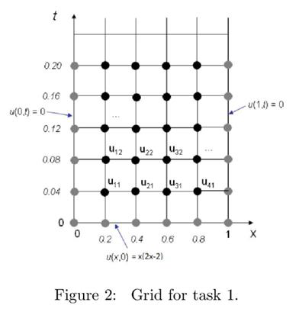
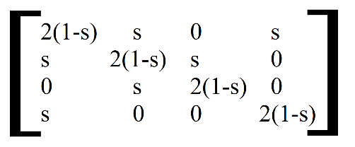
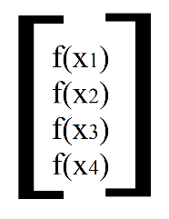
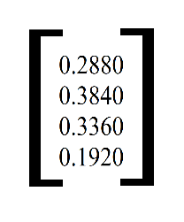
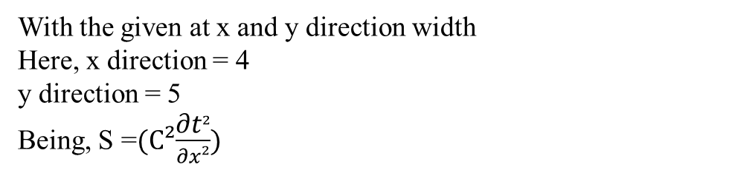
Task 1:
With the given at x and y direction width
Here, x direction = 4
y direction = 5
Being, S =(C²$\frac{\text{∂}\text{t}²}{∂x²}$)
A =
B =
=

Slide 13
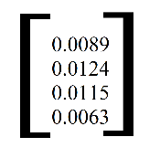
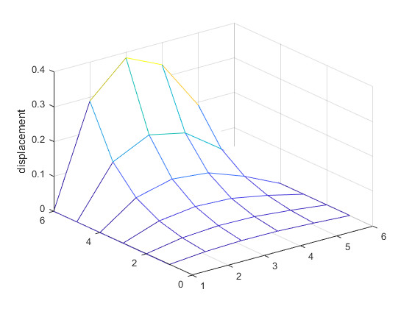
Task 1:
X= A/B =
When, ET =0.2
Now we combine all the values of the grid with
the boundary values and get the result as:
V =
0 0.0089 0.0124 0.0115 0.0063 0
0 0.0179 0.0247 0.0226 0.0125 0
0 0.0359 0.0491 0.0443 0.0248 0
0 0.0719 0.0974 0.0870 0.0490 0
0 0.1439 0.1934 0.1710 0.0970 0
0 0.2880 0.3840 0.3360 0.1920 0
figure: graph of u(. ; .)

Slide 14
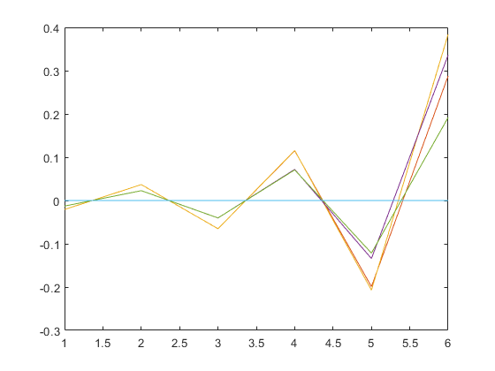
Task 1:
When ET = 𝜋 in 2d graph
The result is:
V =
0 -0.0208 -0.0208 -0.0129 -0.0129 0
0 0.0368 0.0368 0.0228 0.0228 0
0 -0.0651 -0.0652 -0.0403 -0.0402 0
0 0.1150 0.1156 0.0719 0.0708 0
0 -0.1991 -0.2070 -0.1341 -0.1216 0
0 0.2880 0.3840 0.3360 0.1920 0
figure: graph of u (. ; 𝜋)

Slide 15
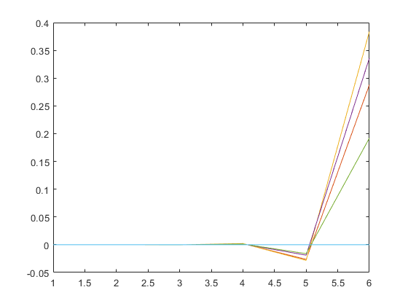
Task 1:
When ET = 2π in in 2d graph
The result is:
V =
0 -0.0000 -0.0000 -0.0000 -0.0000 0
0 0.0000 0.0000 0.0000 0.0000 0
0 -0.0002 -0.0002 -0.0001 -0.0001 0
0 0.0021 0.0021 0.0013 0.0013 0
0 -0.0265 -0.0283 -0.0189 -0.0161 0
0 0.2880 0.3840 0.3360 0.1920 0
figure: graph of u (. ; 2𝜋)

Slide 16
MATLAB codes for Task 1
% creating variables for grid X and Y directions
initial_time=0;
pie=3.1415;
pie_2=2*pie;
ET=0.2; % end time in time(Y-axis)
Nx=5; %grid division in X-direction
Ny=5; % grid division in Y-direction
h=1/Nx; % width in X-direction
k=ET/Ny; % width in Y-direction
L=1; % Bars length
C=1; % String constant
% Initializing grid entries
grid_y= [k:k:ET];
grid_x=[h:h:(1-h)]; % grid of valid entries for u(x,0)
% defining coefficient
s=((C*k)/h)^2;

Slide 17
MATLAB codes for Task 1
% initialization,declaration and defination of A Matrix
A=zeros(4,4);
I=2*(1-s)*eye(4,4);
alphas_diag=[s s 0];
corner_diag=[s];
A=I+diag(alphas_diag,1)+diag(alphas_diag,- 1)+diag(corner_diag,3)+diag(corner_diag,-3);
%initialisation, declaration and defination of B Vector
displacement_i=(grid_x.*(grid_x-2).*(grid_x-1))';
% valid displacement grid entries or "B" vector
initial_grid=displacement_i;
grid_points_n=zeros(4,5);
%ii=repmat(1,4,4);
for i=1:Ny
B=displacement_i;
XX=A\B;
displacement_i=XX;
grid_points_n(:,i)=XX;
end

Slide 18
MATLAB codes for Task 1
grid_points_i=horzcat(initial_grid,grid_points_n);
boundries=zeros(Ny+1,1);
grid_points=flipud(grid_points_i');
V=horzcat(boundries,grid_points,boundries);
mesh(V);
display(V);
zlabel('displacement');
if(ET==pie||ET==pie_2||ET==initial_time)
plot(V);
end

Slide 19
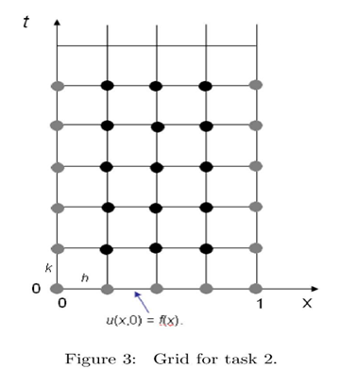
Task 2
function [u] = waveSolution(f ,h,k,ET)
here, f = displacement
h = width in x direction
k = width in y direction
ET = end time
So, u(m,n)= waveSolution(f ,h,k,ET)
Where, m= (m-1)*h
n= (n-1)*k/T

Slide 20
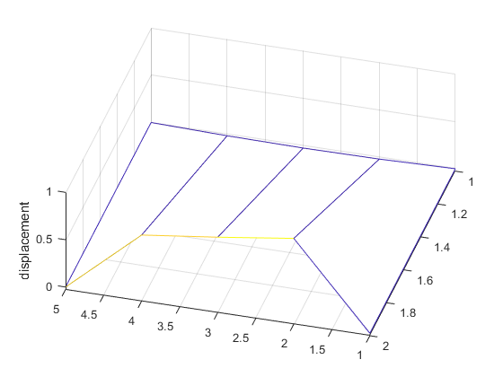
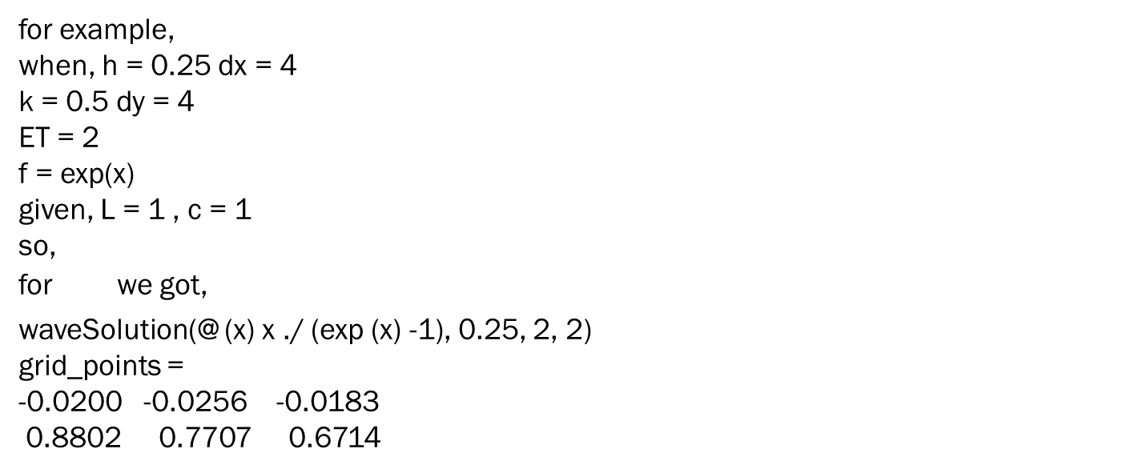
Task 2:
for example,
when, h = 0.25 dx = 4
k = 0.5 dy = 4
ET = 2
f = exp(x)
given, L = 1 , c = 1
so,
for $\frac{x}{1−e^{x}}$ we got,
waveSolution(@ (x) x ./ (exp (x) -1), 0.25, 2, 2)
grid_points =
-0.0200 -0.0256 -0.0183
0.8802 0.7707 0.6714
figure : waveSolution(@ (x) x ./ (exp (x) -1), 0.25, 2, 2)

Slide 21
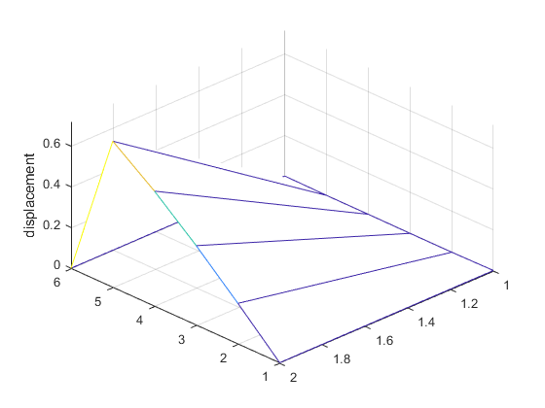
Task 2:
Again,
when, h = 0.2 dx = 5
k = 0.5 dy = 4
ET = 2
f = sin(x)
given, L = 1 , c = 1
so, for sin(x)
we got,
waveSolution(@sin, 0.2, 4, 2)
grid_points =
-0.0031 -0.0032 -0.0023 -0.0024
0.1987 0.3894 0.5646 0.7174
figure: waveSolution(@sin, 0.2, 4, 2)

Slide 22
Matlab codes for (task 2) waveSolution(f ,h,k,ET)
% initialization,declaration and defination of A Matrix
A=zeros(dx,dx); % memory allocation with M-1 and N-1 entries
I=2*(1-s)*eye(dx,dx); % initializing and defining main diagonal with 2*(1-s) (M * times)
diag_1=repmat([s; s; 0],dx,1); % initializing and defining diagonal with repeting s s 0 (M * times)
diag_2= repmat(s,dx,1); % initializing and defining diagonal with all s (M * times)
% definition of A matrix depending on the M entries
if (dx==1)
A=I;
else if (dx==2)
last_diag= diag_1(1:dx-1,1);
A=I+diag(last_diag,+1)+diag(last_diag,-1);
else
last_diag= diag_1(1:dx-1,1);
last_diag_all_s=diag_2(1:dx-3,1);
A=I+diag(last_diag,+1)+diag(last_diag,-1)+diag(last_diag_all_s,+3)+diag(last_diag_all_s,-3);
end
end

Slide 23
Matlab codes for (task 2) waveSolution(f ,h,k,ET)
% This Matlab code will create a function which has as parameters a
% displacement function of spring, number of step with given lenght and
% number of steps with given END TIME
function [U] = waveSolution(f,h,k,ET);
L=1; % Bars length
C=1; % String constant
dx=(L/h)-1; % number of steps in X-direction with valid entries M-1(Note: grid entries are without boundries)
dy=round(ET/k); % number of steps in y-direction till given END POINT
% Initializing valid grid entries
grid_x=[h:h:(1-h)]'; % grid of valid entries for u(x,0)
% defining coefficient
s=((C*k)/h)^2; % calculating the constant from differential equation

Slide 24
Matlab codes for (task 2) waveSolution(f ,h,k,ET)
% %initialisation, declaration and defination of B Vector
displacement_i=f(grid_x); % valid displacement grid entries or "B" vector
initial_grid=displacement_i;
grid_points_n=zeros(dx,dy); % memory allocation for grid entries without boundires for loop
for i=1:dy
B=displacement_i;
XX=A\B;
displacement_i=XX;
grid_points_n(:,i)=XX; % definition and declaration of grid entries without boundries
end
grid_points_i=horzcat(initial_grid,grid_points_n); % complete grid with initial displacement entries
boundries=zeros(dy+1,1); % N-1 times zeros for start and end point fixed boundries
grid_points=flipud(grid_points_i');
V=horzcat(boundries,grid_points,boundries); % complete grid of [U]=((M-1)*h,(N-1)*k)
mesh(V);
zlabel('displacement');
display(grid_points);
end

Slide 25
The end
Thank you

